Slide 1

User Interface System

Slide 2
Learning Objectives
Understand the core concepts of Unity UI
Master layout techniques
Implement event handling
Optimize UI performance
Design user-friendly interfaces
Integrate UI with other game systems

Slide 3
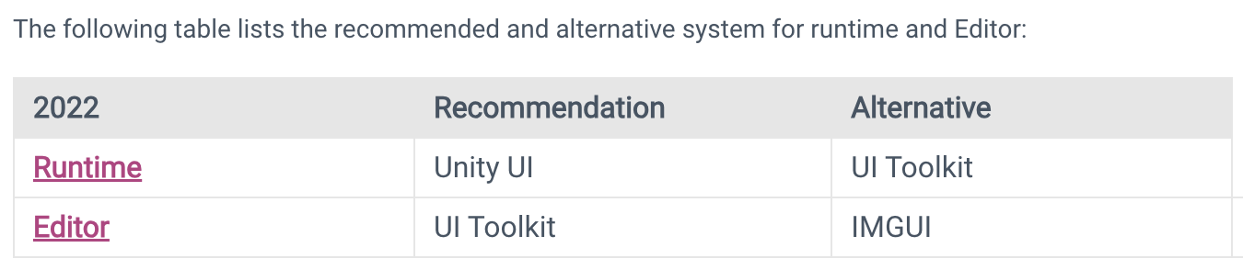
User interface (UI)
Unity provides three UI systems that you can use to create user interfaces (UI) for the Unity Editor and applications made in the Unity Editor:
UI Toolkit
The Unity UI package (uGUI)
IMGUI
References: https://docs.unity3d.com/2022.3/Documentation/Manual/UIToolkits.html

Slide 4
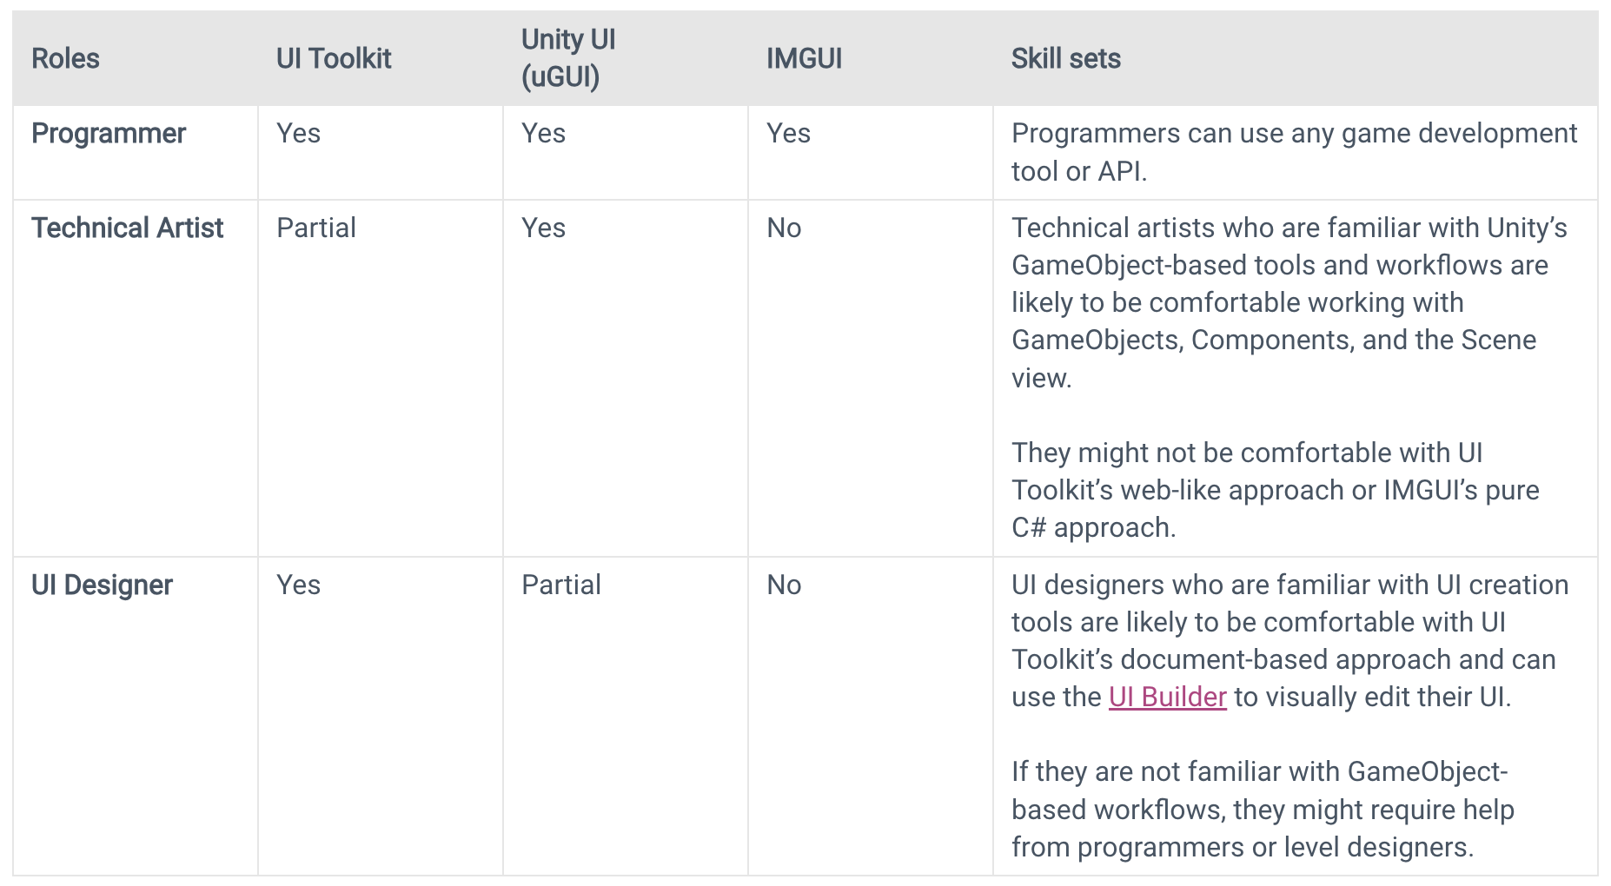
Comparison of UI systems in Unity
References: https://docs.unity3d.com/2022.3/Documentation/Manual/UI-system-compare.html

Slide 5
Unity UI (uGUI)
Unity UI is a set of tools for developing user interfaces for games and applications. It is a GameObject-based UI system that uses Components and the Game View to arrange, position, and style user interfaces. You cannot use Unity UI to create or change user interfaces in the Unity Editor.
In Unity UI, you use components and the Game view to arrange, position, and style the user interface. It supports advanced rendering and text features.
References: https://docs.unity3d.com/2022.3/Documentation/Manual/com.unity.ugui.html

Slide 6
Unity UI (uGUI)
Flexible UI System: Build intuitive and visually appealing user interfaces for games and applications.
Key Components:
Canvas: The foundation of your UI hierarchy.
Image: Displays images, textures, or sprites.
Text: Displays text labels.
Button: Creates interactive buttons.
Slider: Allows users to select a value from a range.
Toggle: Provides on/off options.
Dropdown: Displays a list of options.
Scroll View: Enables scrolling through content.

Slide 7
Unity UI (uGUI)
Layout Components:
Horizontal Layout Group: Arranges children horizontally.
Vertical Layout Group: Arranges children vertically.
Grid Layout Group: Arranges children in a grid.
Canvas Render Mode:
Screen Space - Overlay: Renders UI elements on top of the 3D scene.
Screen Space - Camera: Renders UI elements in 3D space, affected by camera perspective.
World Space: Renders UI elements in world space, interacting with 3D objects.
UI Event System:
Handle user input (clicks, drags, touches) and trigger events.
Customize event handling with scripts.

Slide 8
Unity UI (uGUI)
Core Components:
Canvas:
The foundation of your UI hierarchy.
Sets the rendering mode (Screen Space - Overlay, Screen Space - Camera, World Space).
Image:
Displays images, textures, or sprites.
Can be used for backgrounds, buttons, or other visual elements.
Text:
Displays text labels.
Customize font, size, color, and alignment.

Slide 9
Unity UI (uGUI)
Core Components:
Button:
Creates interactive buttons.
Trigger events on click or hover.
Slider:
Allows users to select a value from a range.
Useful for settings, volume control, or progress bars.
Toggle:
Provides on/off options.
Can be used for checkboxes or switches.

Slide 10
Unity UI (uGUI)
Core Components:
Dropdown:
Displays a list of options.
Useful for selecting options from a predefined list.
Scroll View:
Enables scrolling through content that exceeds the viewport.
Ideal for long lists or menus.

Slide 11
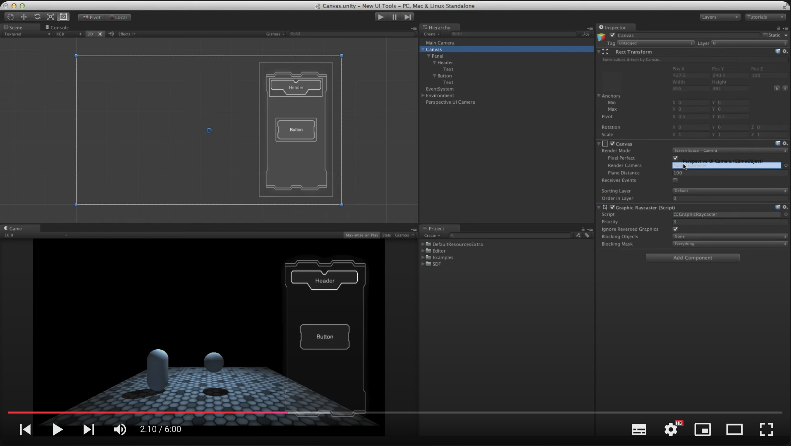
Unity UI (uGUI)
Tutorials – Beginner UI
References: https://www.youtube.com/watch?v=OD-p1eMsyrU&list=PLX2vGYjWbI0Qp0sD8_RKgbWul7z_eyNAv

Slide 12
Unity UI (uGUI)
What is the Event System?
A system for managing and handling user input events.
Facilitates communication between input devices, UI elements, and game objects.
Consists of key components: Event System, Input Modules, and Raycasters.

Slide 13
Unity UI (uGUI)
Key Components:
Event System:
Manages active input modules.
Coordinates raycasting to determine the object under the pointer.
Updates input modules and sends events to objects.
Input Modules:
Handle specific input types (e.g., mouse, touch, keyboard).
Process input data and send events to objects.
Raycasters:
Determine which object is being pointed at.
Types: Graphic Raycaster (for UI elements), Physics 2D Raycaster (for 2D physics objects), Physics Raycaster (for 3D physics objects).

Slide 14
Unity UI (uGUI)
How it Works:
Input: User interacts with the game (e.g., mouse click, touch).
Input Module: Processes the input and determines the event type (e.g., pointer click, drag, hover).
Raycasting: Determines the object being pointed at using Raycasters.
Event Sending: The Event System sends the appropriate event to the target object.
Event Handling: The target object's script handles the event and responds accordingly.
Event Handling:
UI Components: Built-in UI components (e.g., Button, Slider) have built-in event handling mechanisms.
Custom Scripts: Implement event interfaces (e.g., IPointerClickHandler, IPointerEnterHandler) to handle custom events.

Slide 15
Recap
Unity UI is a powerful system for creating user interfaces in Unity. It offers a range of components to build interactive and visually appealing UI elements:
Core Components: Canvas, Image, Text, Button, Slider, Toggle, Dropdown, Scroll View
Layout Components: Horizontal Layout Group, Vertical Layout Group, Grid Layout Group
Event System: Handles user input and triggers events.
By understanding these components and their interactions, you can design and implement user interfaces for your Unity projects.

